Slide 1
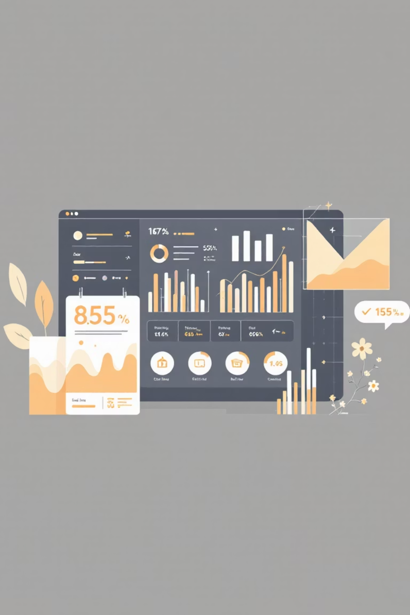
Customer Shopping Behavior Analysis
Uncovering insights from 3,900 purchases to guide strategic business decisions

Slide 2
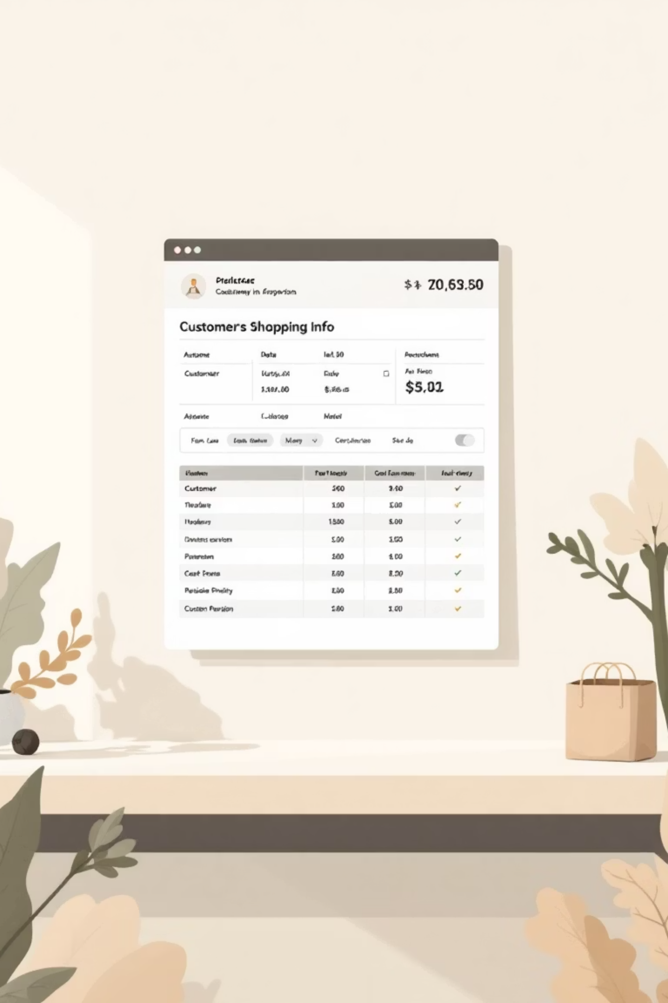
DATASET OVERVIEW
The Foundation
3,900
18
37
Total Purchases
Data Points
Missing Values
Transactions analyzed
Features per transaction
In Review Rating column
Customer Demographics
Purchase Details
Age, Gender, Location
Item, Category, Amount
Subscription Status
Season, Size, Color

Slide 3

PYTHON ANALYSIS
Data Preparation & Cleaning
01
02
Data Loading
Initial Exploration
Imported dataset using pandas
Used df.info() and .describe() for summary statistics
03
04
Missing Data Handling
Column Standardization
Imputed Review Rating using median by category
Renamed to snake_case for readability
05
06
Feature Engineering
Database Integration
Created age_group and purchase_frequency_days
Connected to PostgreSQL for SQL analysis

Slide 4
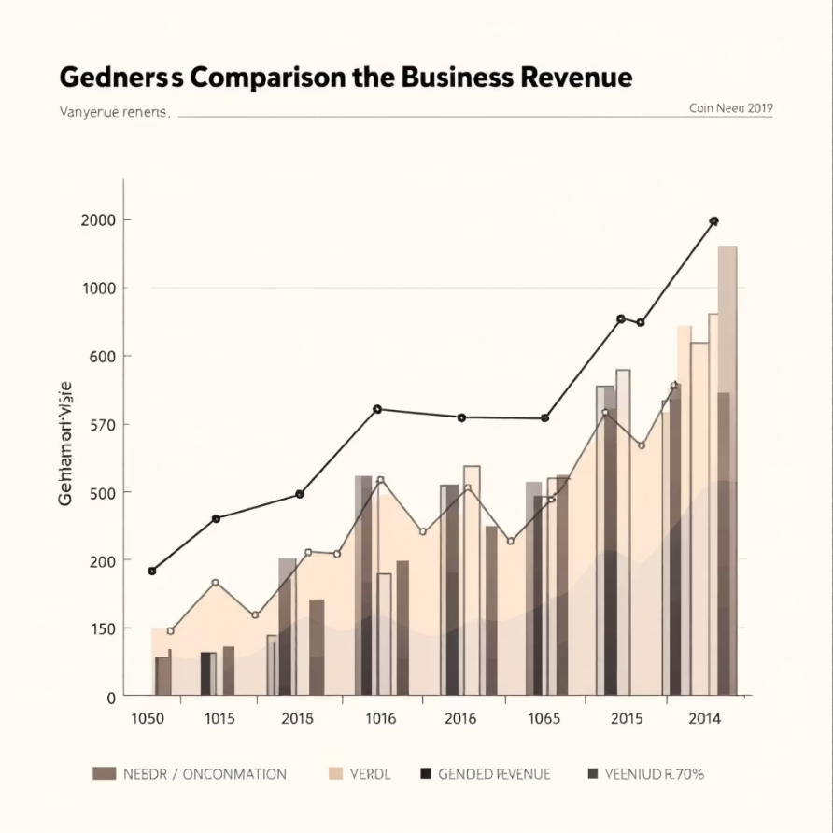


SQL INSIGHTS
Revenue Analysis
Gender Comparison
Total revenue generated by male vs. female customers shows balanced spending patterns
Shipping Preferences
Express shipping users show higher average purchase amounts compared to Standard
68%
32%
Customers using Express shipping
Standard shipping preference

Slide 5

High-Value Discount Users
Strategic Finding
Business Opportunity
Action Item
Identified customers who used discounts but still spent above average purchase amount
These customers respond to promotions without sacrificing transaction value
Target this segment with exclusive offers to drive loyalty

Slide 6

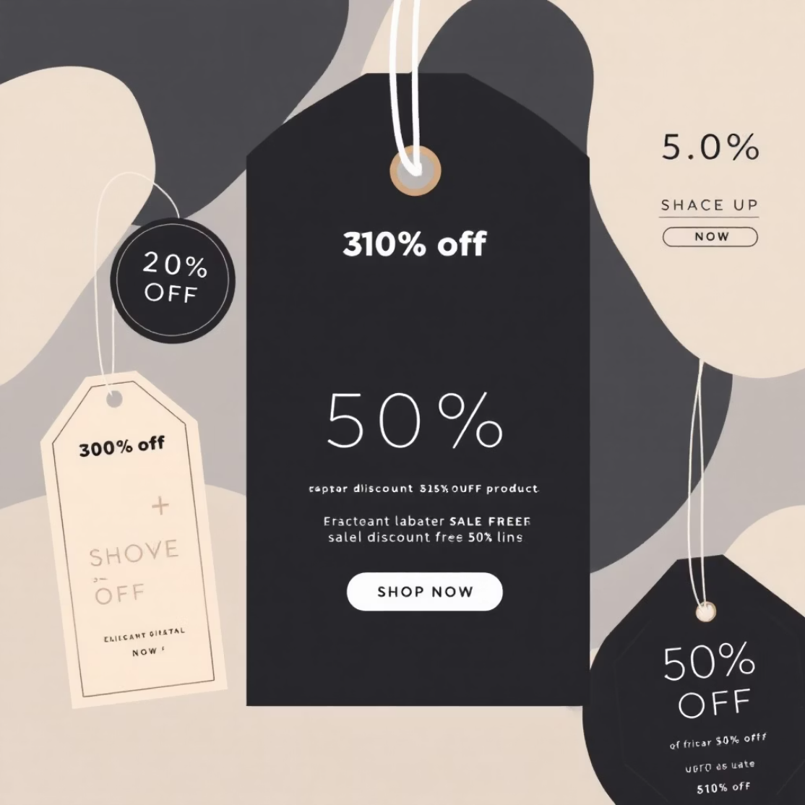

PRODUCT PERFORMANCE
Top-Rated Products & Categories
Highest Review Ratings
Discount-Dependent Items
Top 5 products identified with exceptional customer satisfaction
5 products with highest percentage of discounted purchases reveal price sensitivity
Key Insight: Top-rated products should be highlighted in marketing campaigns, while discount-dependent items need strategic pricing review

Slide 7

Customer Segmentation
New Customers
Returning Customers
First-time buyers exploring product range
2-5 purchases showing growing engagement
Loyal Customers
5+ purchases demonstrating strong brand affinity
Subscription Correlation
Revenue by Age Group
Customers with >5 purchases show higher subscription rates
Middle-aged segments contribute highest total revenue

Slide 8




SUBSCRIBERS VS NON-SUBSCRIBERS
The Subscription Advantage
Higher Spend
Subscribers show elevated average purchase amounts
Greater Revenue
Total revenue significantly higher from subscription base
Loyalty Impact
Subscription drives repeat purchase behavior

Slide 9

POWER BI DASHBOARD
Interactive Insights
Visual Analytics
Interactive dashboard presenting key metrics and trends
Dynamic Filtering
Slice data by demographics, products, and time periods
Actionable Insights
Real-time visibility into customer behavior patterns

Slide 10
Business Recommendations
1
2
3
Boost Subscriptions
Customer Loyalty Programs
Review Discount Policy
Promote exclusive benefits for subscribers to increase conversion
Reward repeat buyers to move them into "Loyal" segment
Balance sales boosts with margin control for sustainable growth
4
5
Product Positioning
Targeted Marketing
Highlight top-rated and best-selling products in campaigns
Focus on high-revenue age groups and express-shipping users
Made by Harshit

